Slide 1
ENSE 470, Milestone 2
ByteThis Software
Taylor Petrychyn, Alwin Baby, and Konstantin Kharitonov
January 18th, 2017

Slide 2
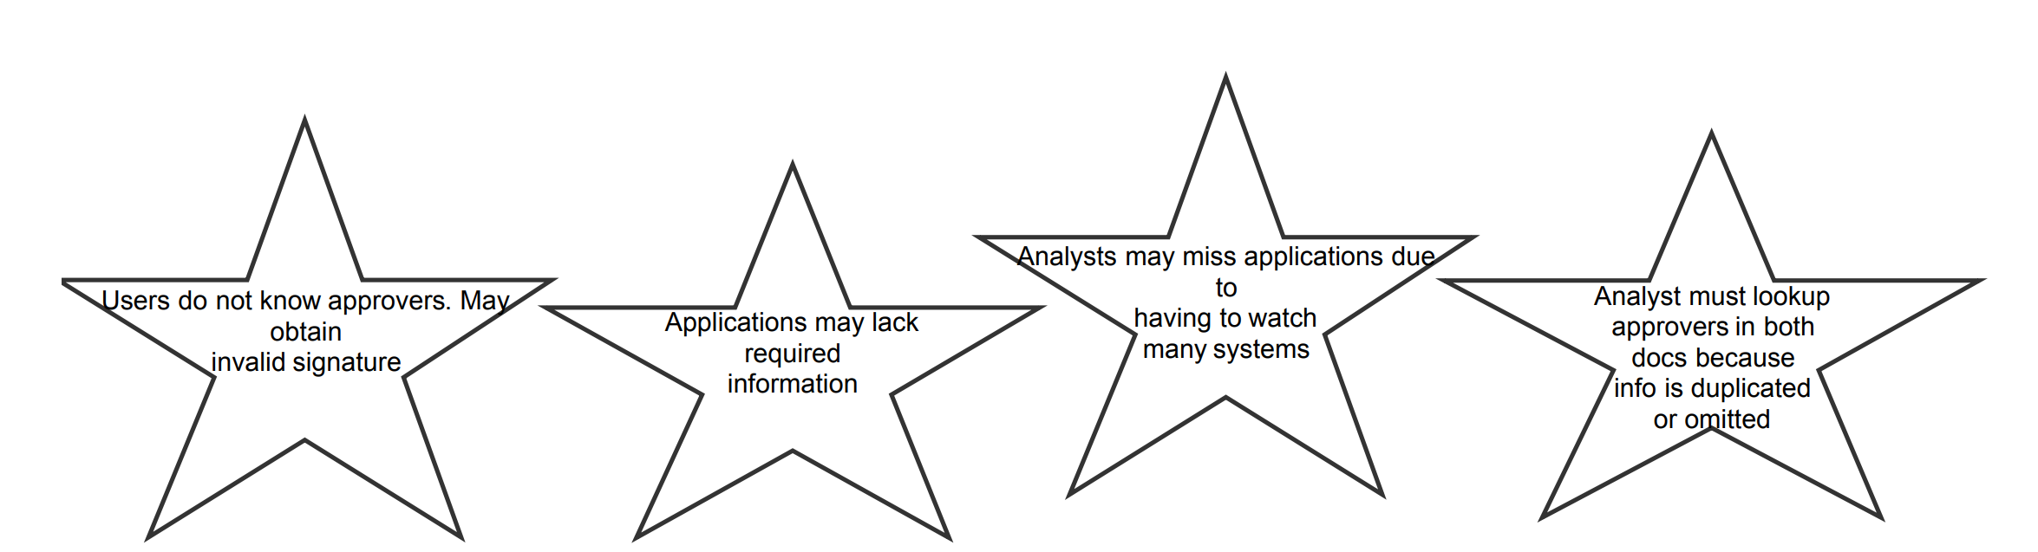
Kaizen Burst from Milestone 1

Slide 3
Ideas!

Slide 4
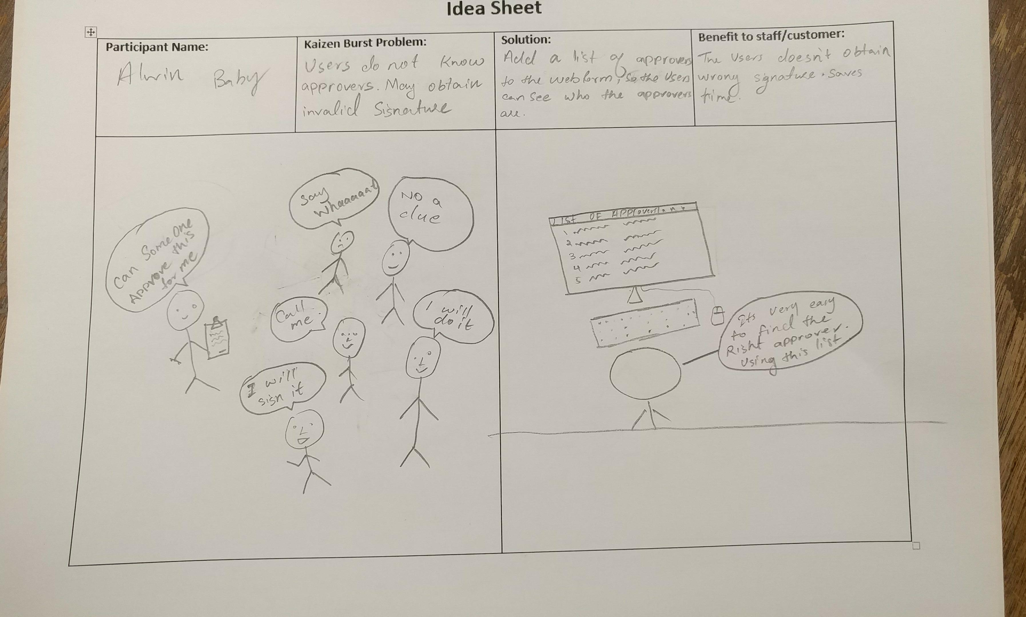

Slide 5
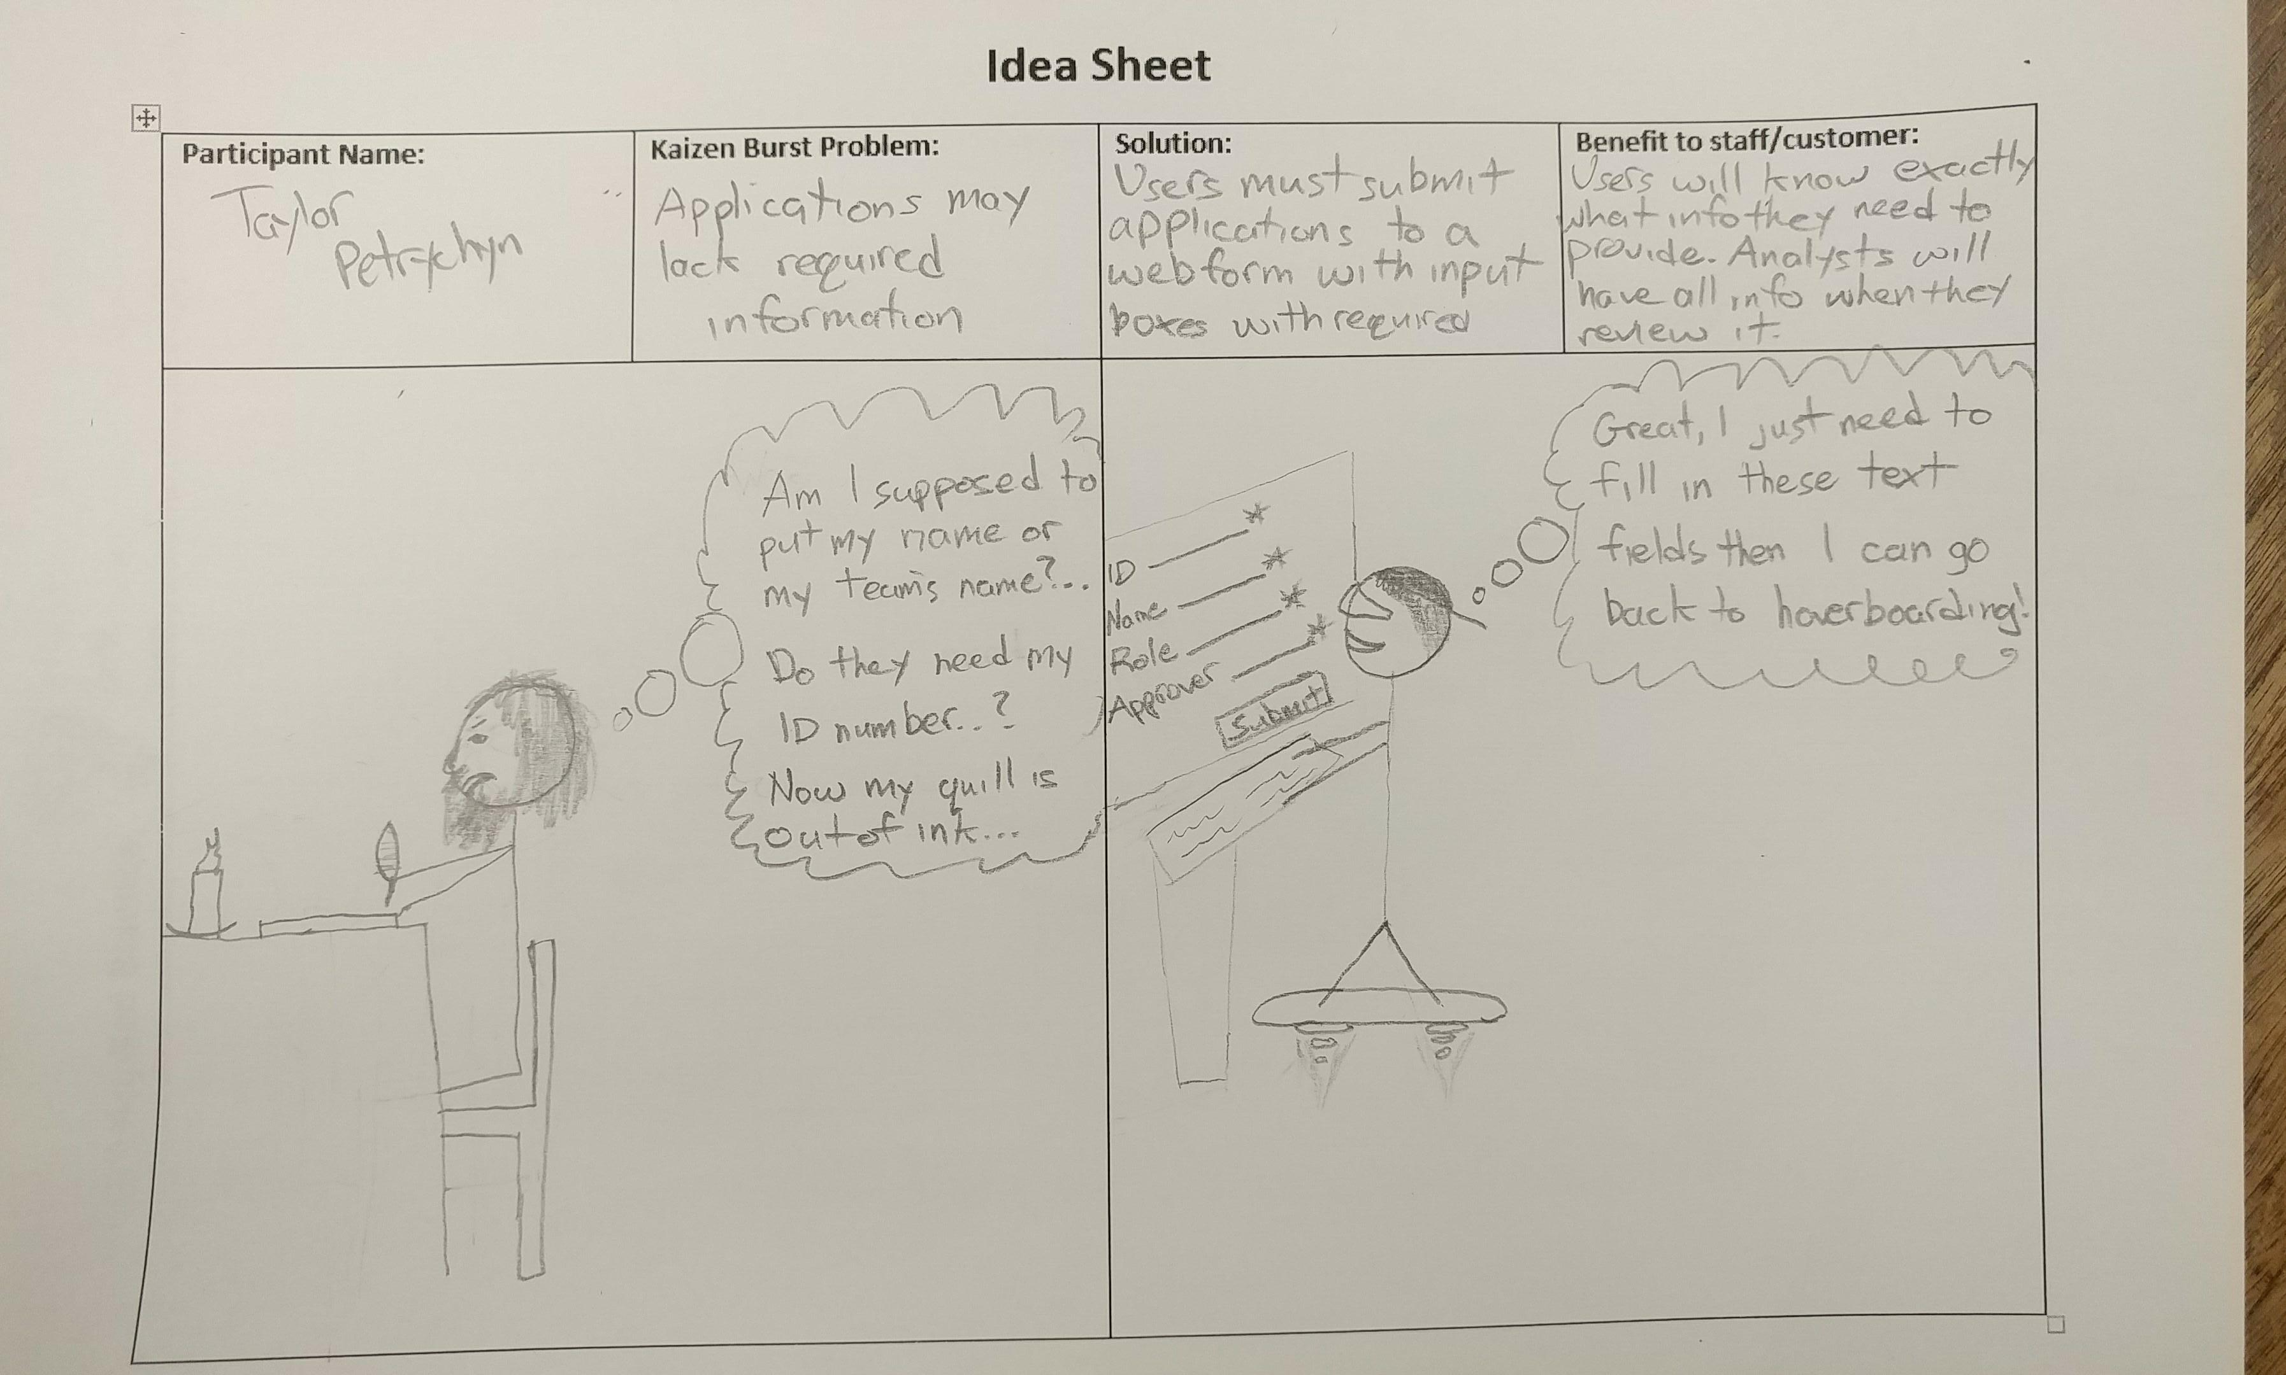

Slide 6
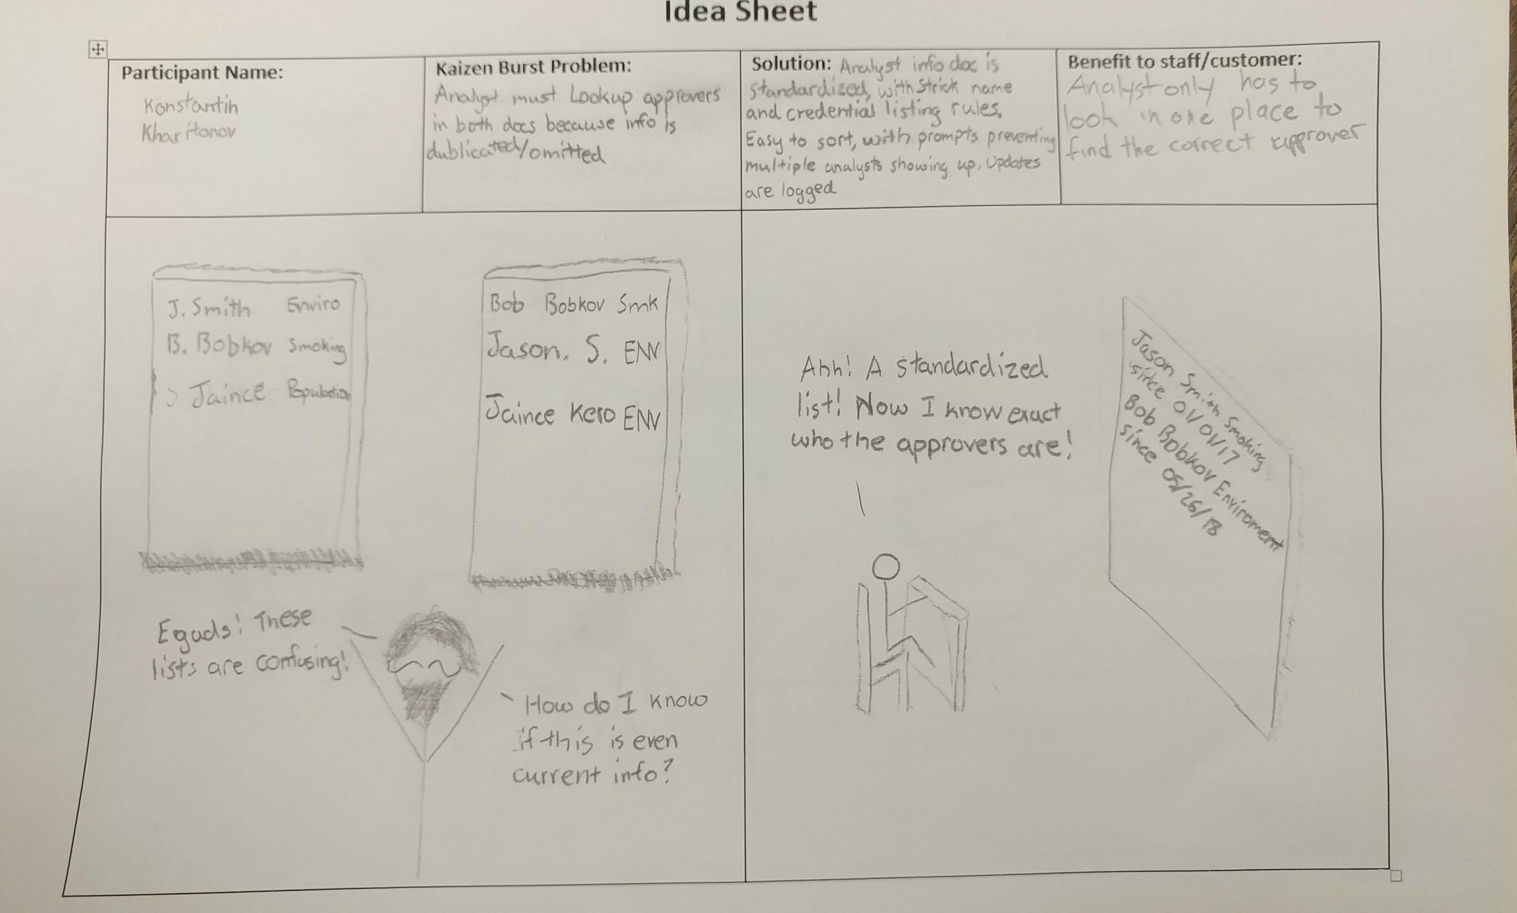

Slide 7
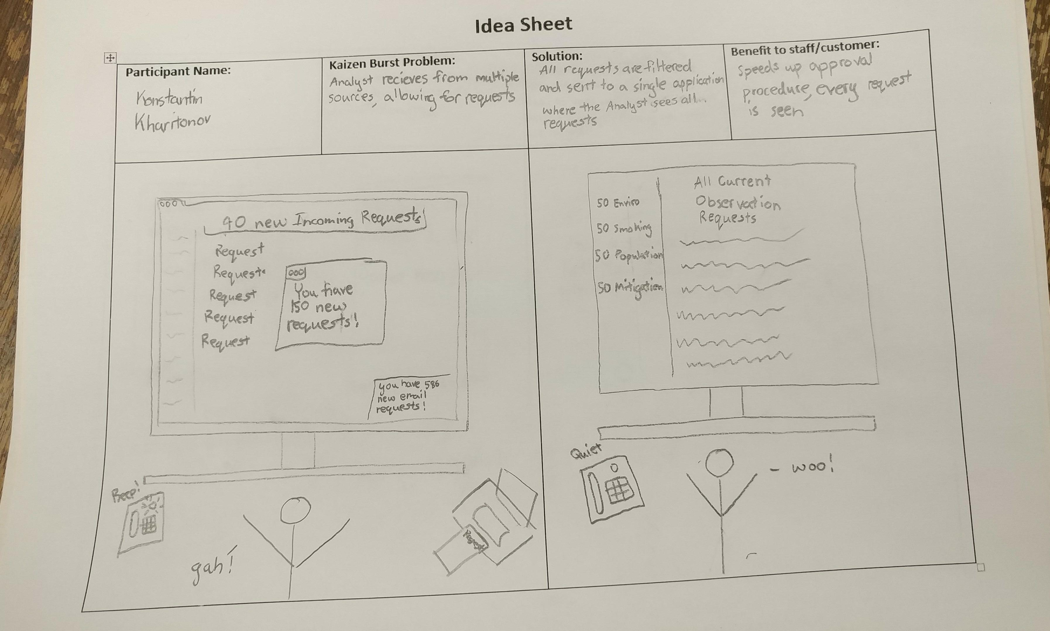

Slide 8
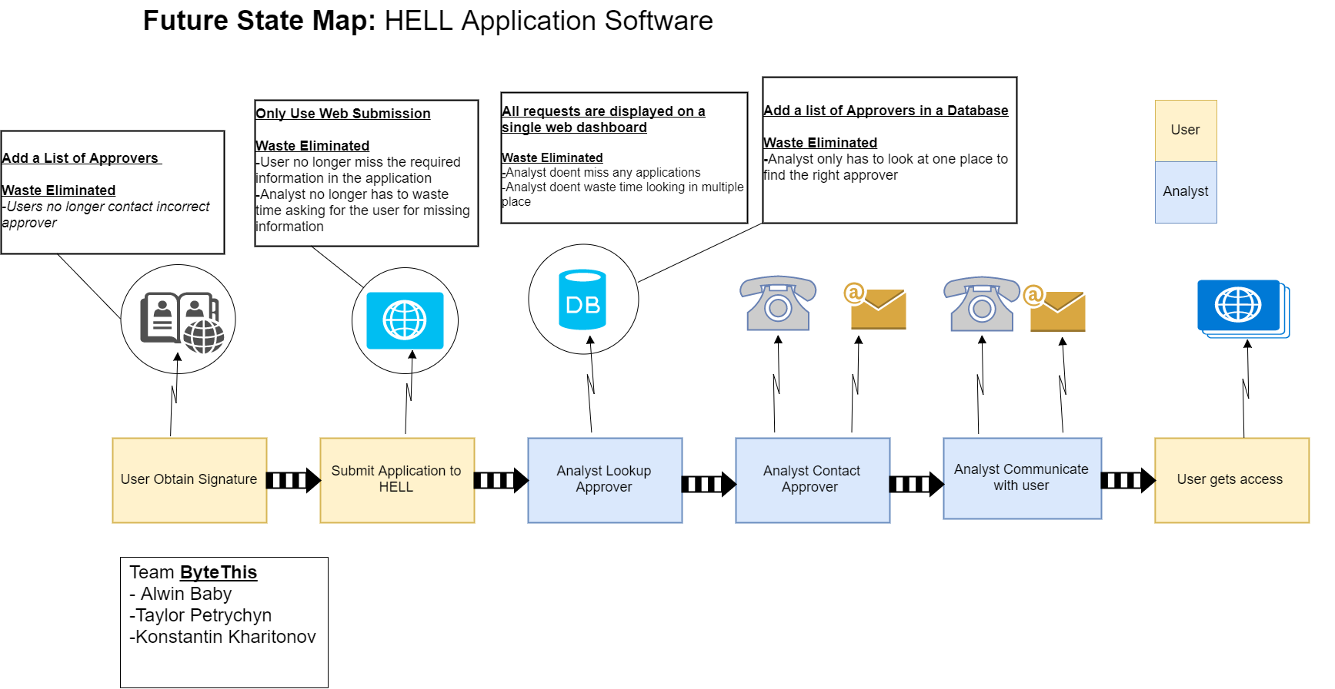

Slide 9
Group reflection
How did you feel about this milestone? What did you like about it? What did you dislike?
  Simple yet important task. We enjoyed creating the VSM, learning about the process.
  Multiple restarts due to poor online tools
What did you learn about yourself as you collaborated and worked through this milestone?
  We haven’t fully utilized this process before
How will you use what you have learned going forward?
  For future assignments
What “stuff & things” related to this milestone would you want help with?
  Finding reliable software for VSM creation

